Slide 1



birth chart analysis of
Ms. ………………………………….. based on
W D Gann Astrononamy
www.stocktradingfundamentals.com

Slide 2
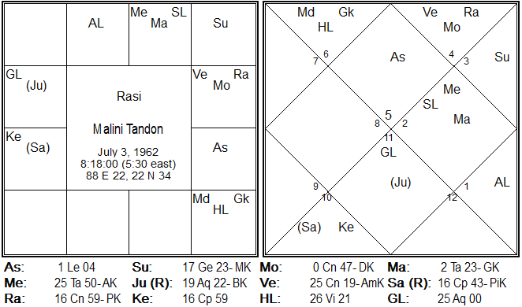
Birth Chart Showing Planetary Position At Time Of Birth

Slide 3
What Each Planet Stands For
Planet | Attribute
Sun | Energy
Moon | Mind
Mars | Strength
Mercury | Speech
Jupiter | Knowledge
Venus | Lust
Saturn | Misery

Slide 4
Birth Chart – Key Features
Sun is the birth lord of native.
Sun is sitting in neutral house .
Saturn and Moon are sitting in own house.
Jupiter is sitting in neutral house .
Mercury is sitting in friendly house but in conjunction with its staunch enemy Mars.
Moon in conjunction with Rahu and Venus.

Slide 5
Birth Chart – Key Features
Natives chart is not ideal for taking trading as a profession.
Moon being eclipsed by Rahu makes mind to be influenced by Node and will be flickery which is not suitable for a short term trader.
Positional strength of birth lord Sun and Jupiter also sitting in okay position native will gain good from correctly timed investment.
Native will gain good from land, property dealings that can be a good profession for native.

Slide 6
Time Line
Month | Dec'13 | Jan'14 | Feb'14 | Mar'14 | Apr'14 | May'14
Trading / Investment
Health
Professional
Month | June'14 | July'14 | Aug'14 | Sep'14 | Oct'14 | Nov'14 | Dec'14
Trading / Investment
Health
Professional
Positive | Highly Positive | Negative | Average

Slide 7
Birth Lord Mantra
To Get Blessings Of Birth Lord
"जपाकुसुमसंकाशं काश्यपेयं महाधुतिम ,
तमोरीम सर्वपापद्नाम प्रणतोमी दिवाकरे "
Recite the above Mantra every day in the morning will help the native in both professional and personal life.

Slide 8
Mantra To Evade Ill Effect Of
Planet Weakley Placed In Birth Chart
"दघिशंग खटूसरभम श्रीरोदारणवासिबभम,
नरनामी शशिनं सोम शब्बोर्मुकुटभुस्नम “
“प्रियंग गुकालिकाशयम रूपेणप्रतिमं बुद्धम ,
सौम्यं सौम्यगुणोपेतं तम बुद्धम प्रणमाम्यहम”
Recite the above Mantra every day in the morning will help the native in both professional and personal life.

Slide 9
Shubha Labha
www.stocktradingfundamentals.com
Swayam Academy
403-C, Fourth Floor , Richmond Plaza, Richmond Circle
Banglore – 560 025
Phone : +91 9243727272
email : feedback@stocktradingfundamentals.com

